Slide 1
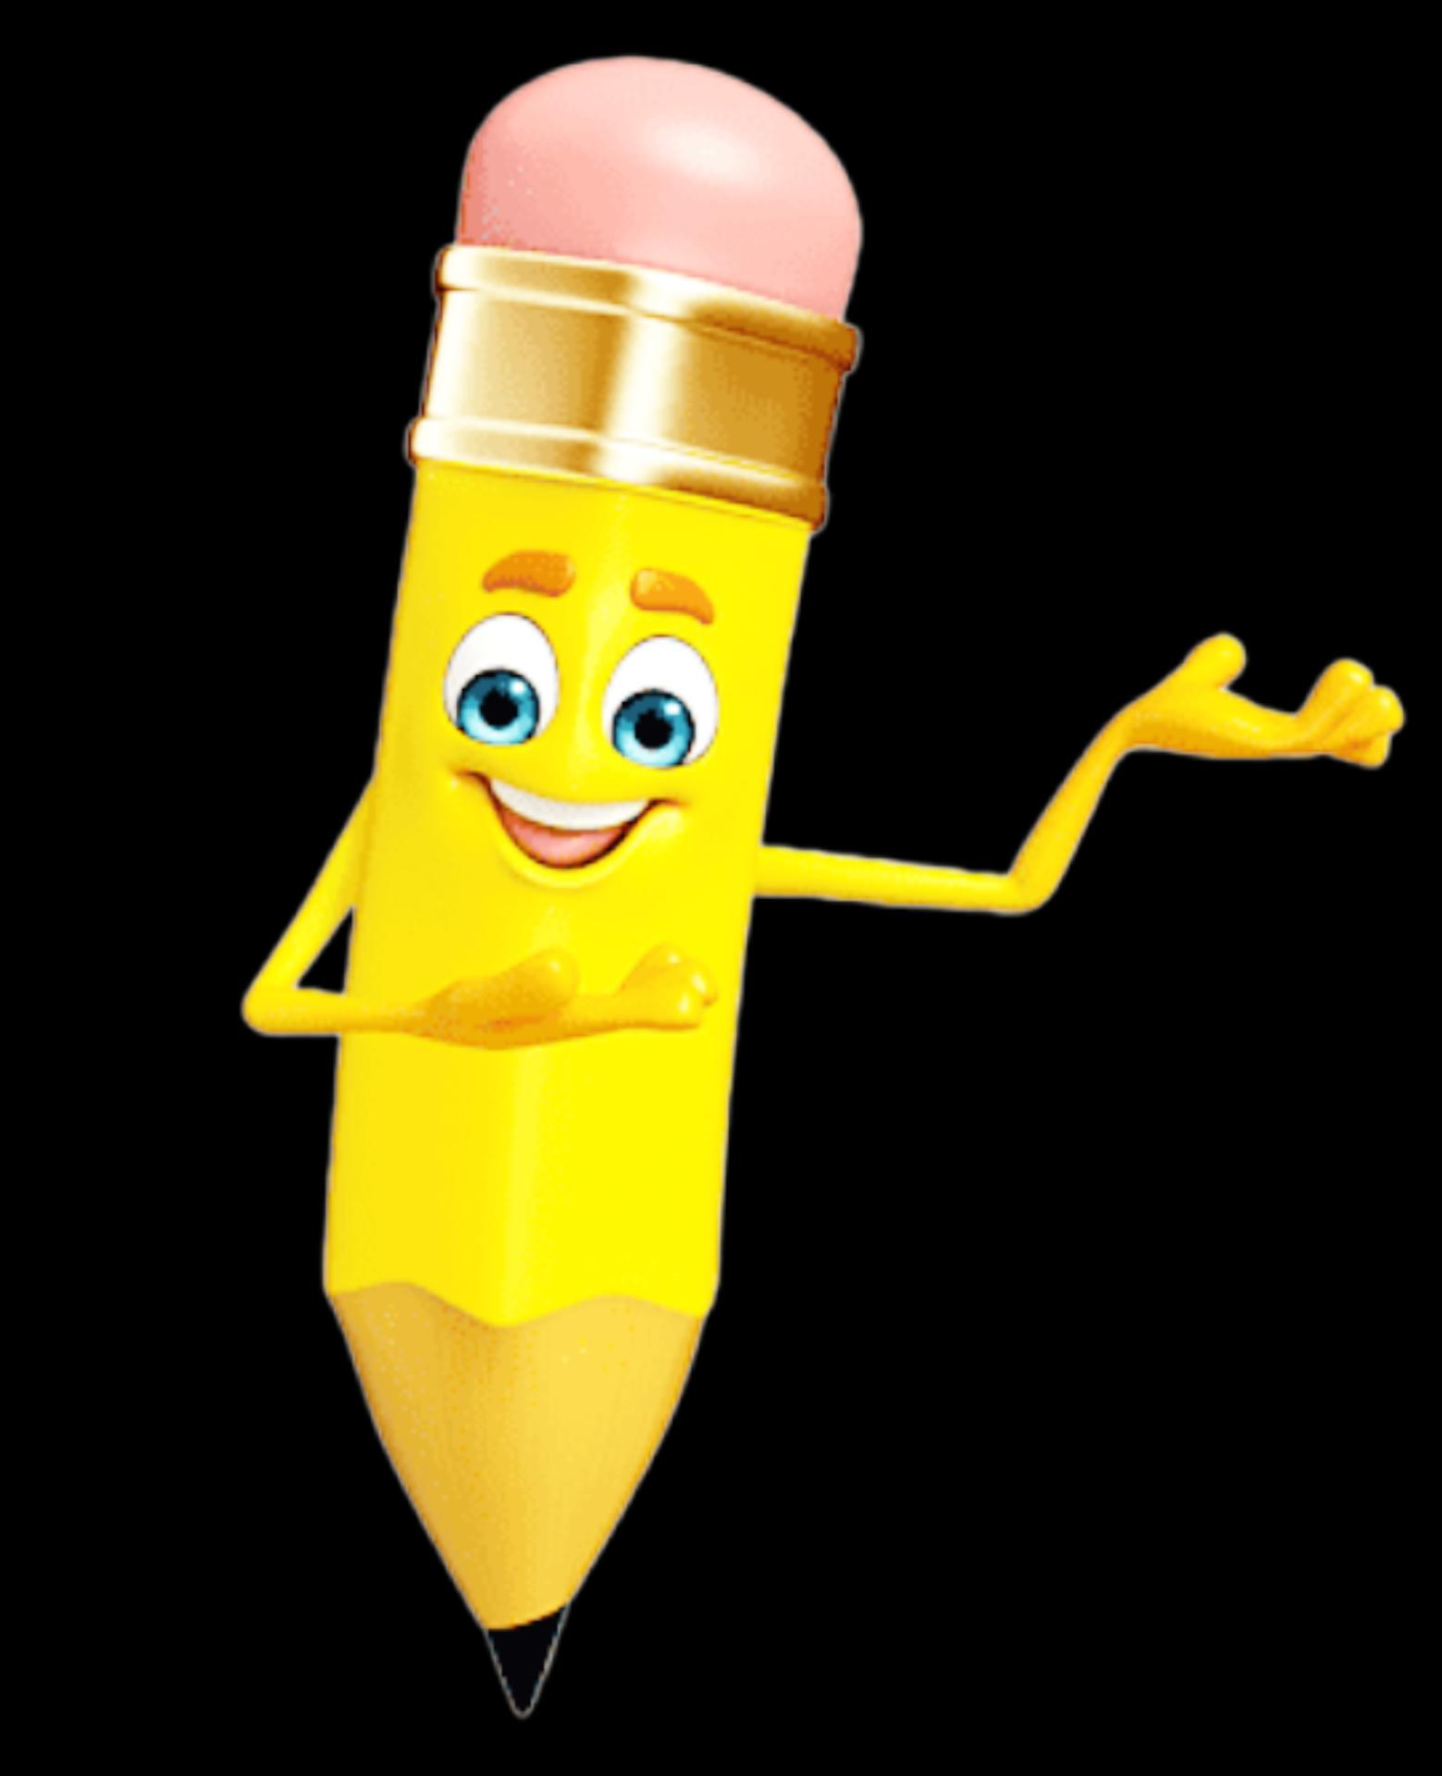
STUDENT NAME: B. Lekha Sri
REGISTER AND NM ID: astvu30430424180026
DEPARTMENT: COMPUTER SCIENCE [s-2]
COLLEGE: Arignar Anna Arts Govt.Arts College(W).walajapet. Ranipet dt
UNIVERSITY: TIRUVALLUR UNIVERSITY

Slide 2
Project Tittle
FRONTEND WEB DEVELOPMENT
MY DIGITAL PORTFOLIO

Slide 3

Agenda
Problem statement
Project overview
End users
Tools& Technique
Portfolio Design& layout
Features and functionally
Results & Screenshots
Conclusion
Github link

Slide 4

PROBLEM STATEMENT
A digital portfolio is an effective tool to present skills, achievements, and experiences in a professional and creative way. It not only showcases personal growth but also builds credibility, making it valuable for education, career, and networking purposes.
We may learn through this learning platforms easily and affordably and attending some quiz makes more interesting about tech things.
4

Slide 5

PROJECT OVERVIEW
A digital portfolio is an online collection that showcases a person’s skills, projects, achievements, and experiences in a creative and professional way. It serves as a personal brand, highlighting both technical and creative abilities through sections like “About Me,” project showcases, quiz,rewards, and contact details. This project provides a colorful, interactive, and user-friendly platform for presenting work to potential employers, educators, or collaborators.
5

Slide 6


WHO ARE THE END USERS?
For a digital portfolio (HTML learning project), the end users are :
Teachers/Instructors – to evaluate your work and learning progress.
Classmates/Peers – to view and get inspired by your portfolio.
Future Recruiters/Employers – to check your skills, achievements, and projects.
Yourself – to track your own learning and growth.
👉 So, the end users are anyone who wants to learn about your skills, projects, and progress in web development.
6

Slide 7

TOOLS AND TECHNIQUES
🛠 Tools :
HTML (HyperText Markup Language)Structure of the webpage.Example: <header>, <main>, <section>, <article>, <footer>.Defines headings, navigation, images, text, links, etc
2. CSS (Cascading Style Sheets)Styling and design of the page.Example: gradients, hover effects, shadows, font styling, rounded corners.File: styles.css.
3. JavaScript (Vanilla JS)Adds interactivity and functionality.Example: The quiz logic (showing questions, checking answers, scoring, hiding/showing buttons).File: script.js.---🌐
Supporting Tools / PlatformsExternal Links & Logos:W3Schools, Edunet (learning platforms).
7

Slide 8

Techniques:
Techniques Used HTML:
Semantic structure (header, section, article, footer), navigation links
CSS: Gradients, shadows, rounded corners, hover effects, responsive design
JavaScript: DOM manipulation, event handling, quiz logic, dynamic content, score tracking.

Slide 9
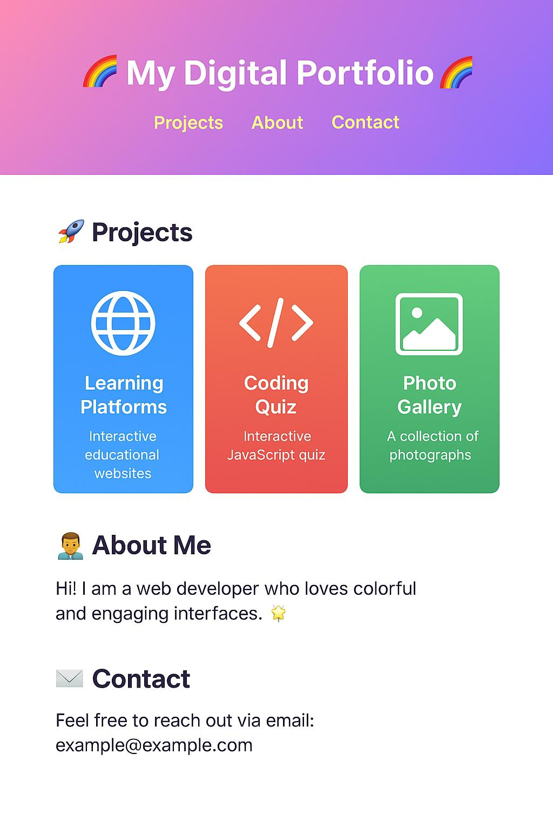
POTFOLIO DESIGN AND LAYOUT
This is layout of my project with quiz,
project, about me, contact
9

Slide 10

My portfolio Design And Layout
This digital portfolio features a vibrant, modern design with a clean layout and responsive structure. The header showcases a colorful title with easy-to-navigate links to Projects, About Me, and Contact sections. Each project is presented with visually engaging cards, including logos and interactive elements. The quiz section adds interactivity, while gradient backgrounds, shadows, and hover effects create a dynamic, eye-catching experience. The About Me and Contact sections are styled consistently to maintain readability and visual appeal, making the portfolio both functional and aesthetically pleasing across devices.

Slide 11
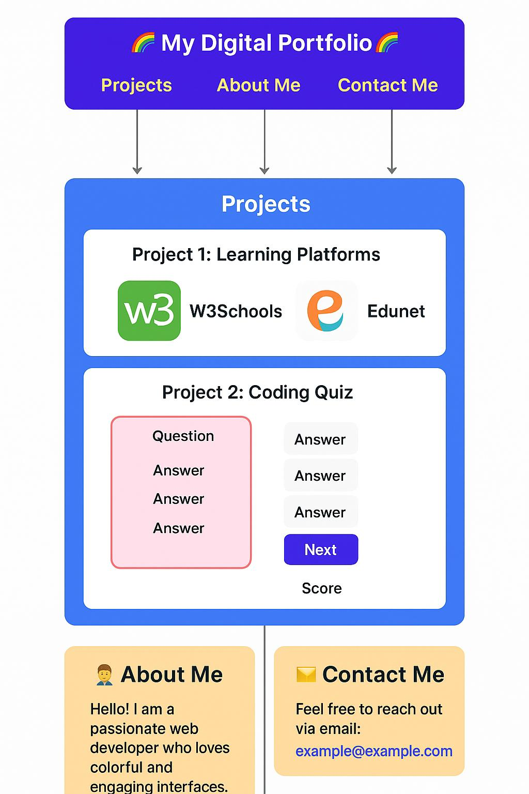
FEATURES AND FUNCTIONALITY

Slide 12
Features
...
Accessibility – Available online anytime, anywhere. Interactive – Allows links, animations, and interactive elements. Organization – Sections like About Me, Projects, Skills, Contact. Updatable – Can be edited and updated anytime. Shareable – Simple link sharing for jobs, colleges, or networking.

Slide 13
Functions
Showcases skills, projects, and achievements. Acts as personal branding and professional identity. Provides proof of learning and growth. Useful for job, internship, and college applications. Builds credibility and trust. Easy to share for networking.

Slide 14
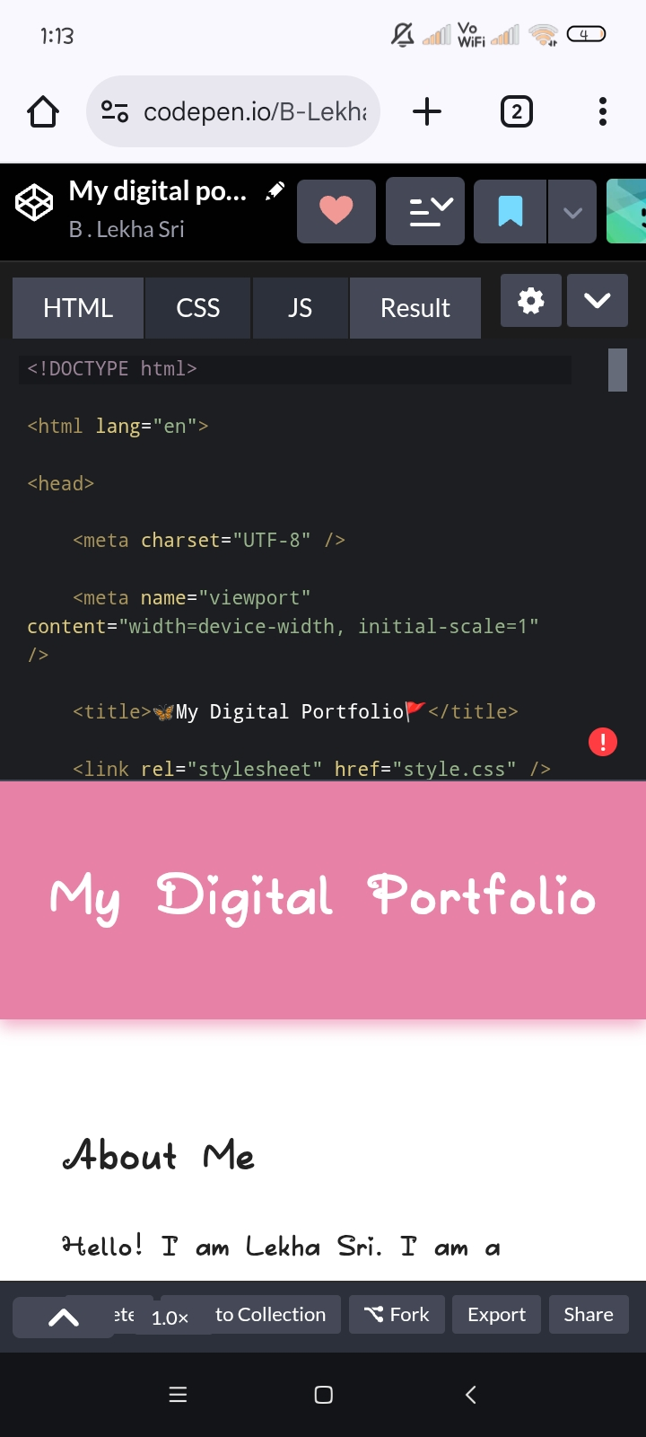
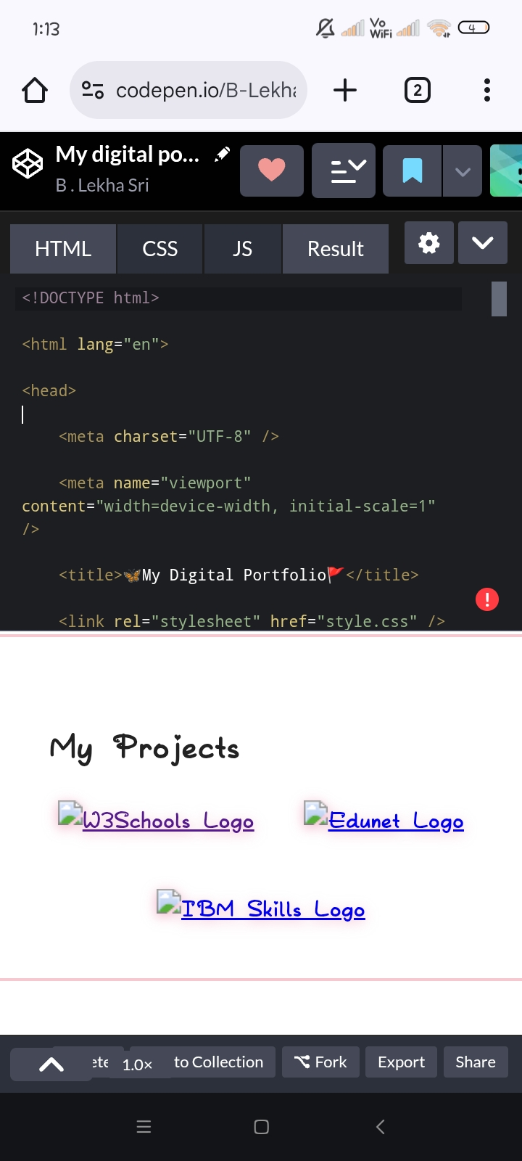
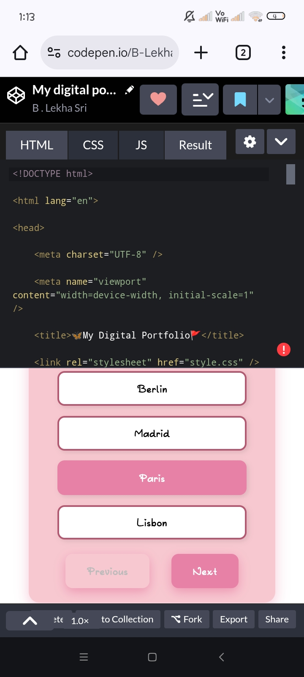

RESULTS AND SCREENSHOTS
3/21/2024 Annual Review
14

Slide 15
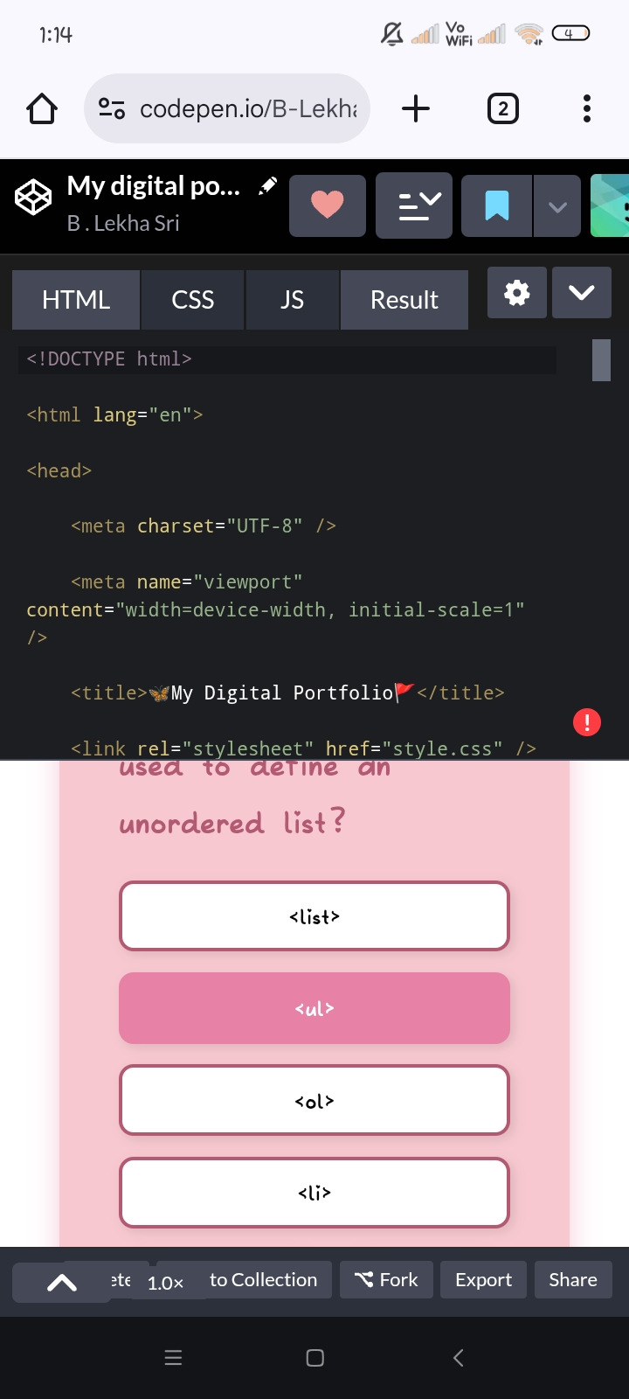
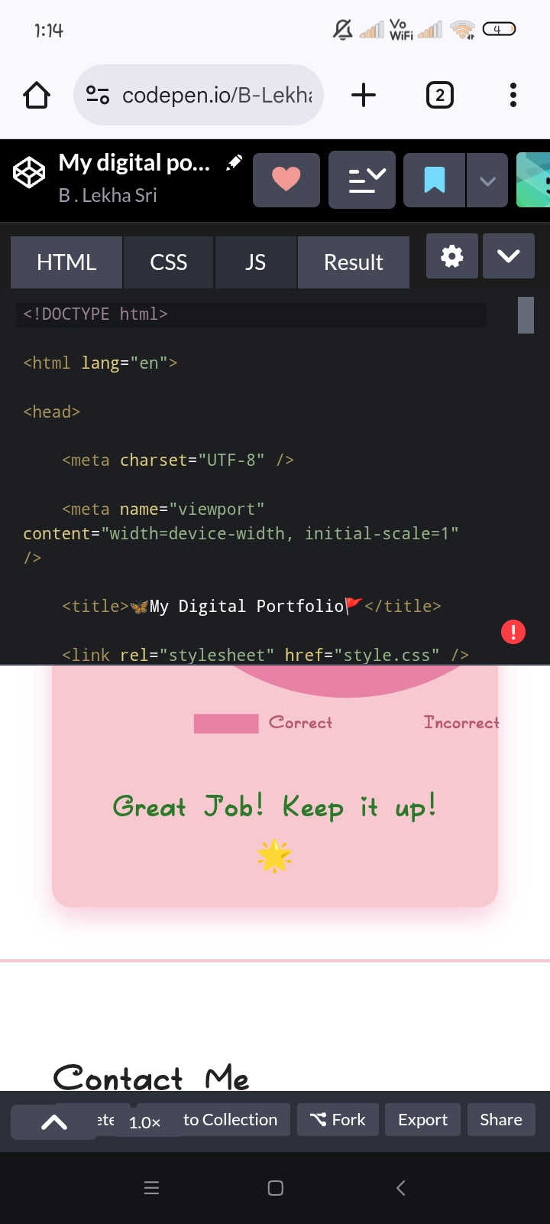
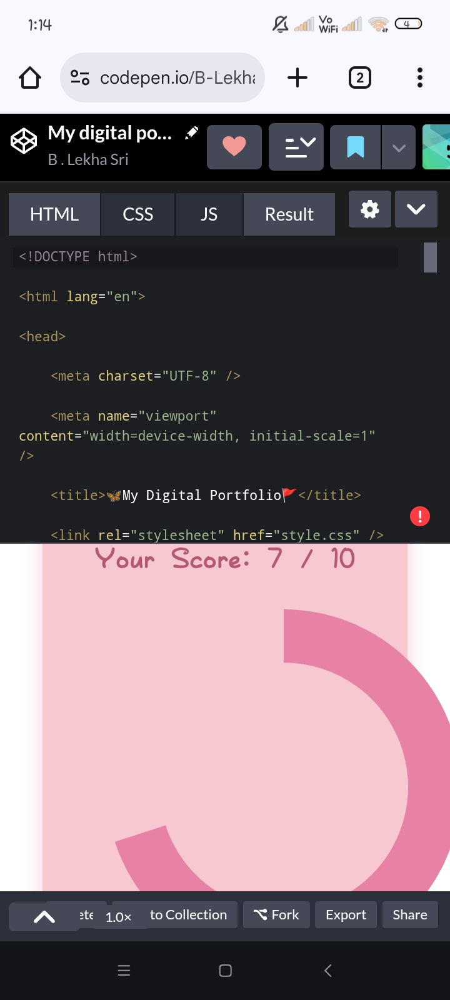
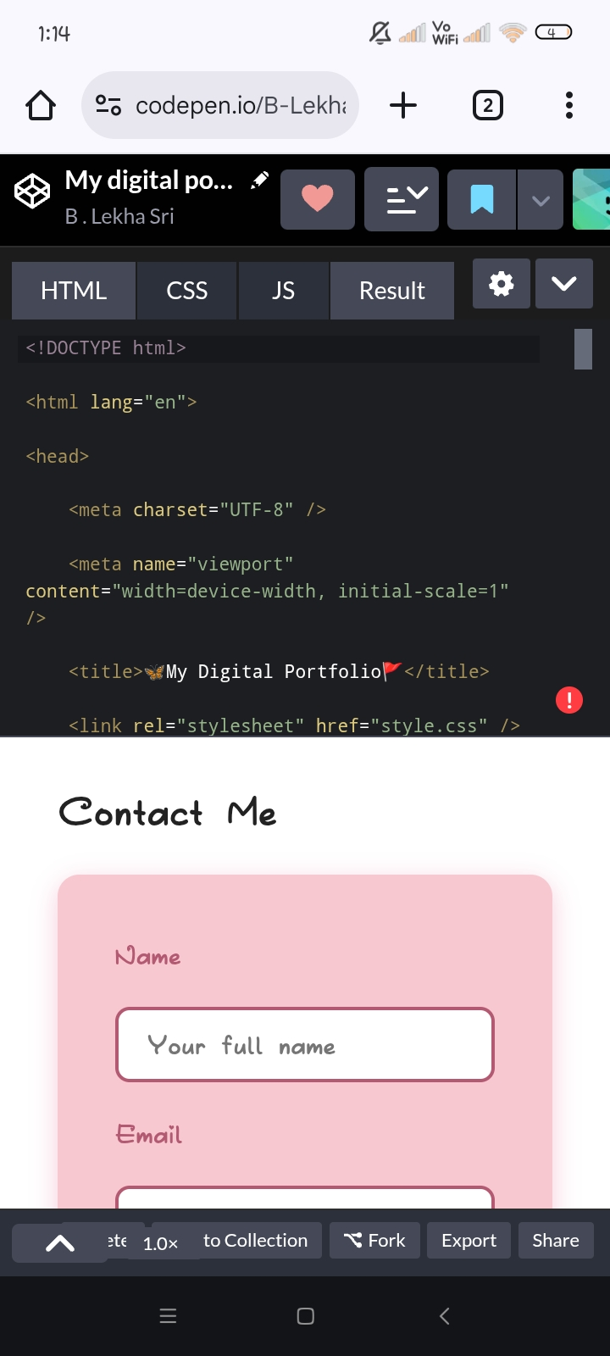

Slide 16

CONCLUSION
In today’s digital era, a digital portfolio serves as a dynamic platform to highlight one’s talents and accomplishments. Unlike traditional resumes, it provides an engaging and interactive way to communicate skills through visuals, projects, and multimedia. Thus, it is an essential tool for students, professionals, and creative individuals to stand out in academic and career opportunities.
A digital portfolio is an effective tool to present skills, achievements, and experiences in a professional and creative way. It not only showcases personal growth but also builds credibility, making it valuable for education, career, and networking purposes.
16

